Slide 1
Final Youtube Project
VARUN VENKITACHALAM
RYAN TANG
CHAMATH GAMALATH

Slide 2
Overview:
Generate a Dataset by extracting information using a youtube Developers ID
Use a large youtube dataset and obtain the top 5 categories along with the ratings of each view
Incorporate Hadoop Map reduce and obtain more than 1 split

Slide 3
Getting the data
Go to https://console.cloud.google.com and login using a gmail account

Slide 4
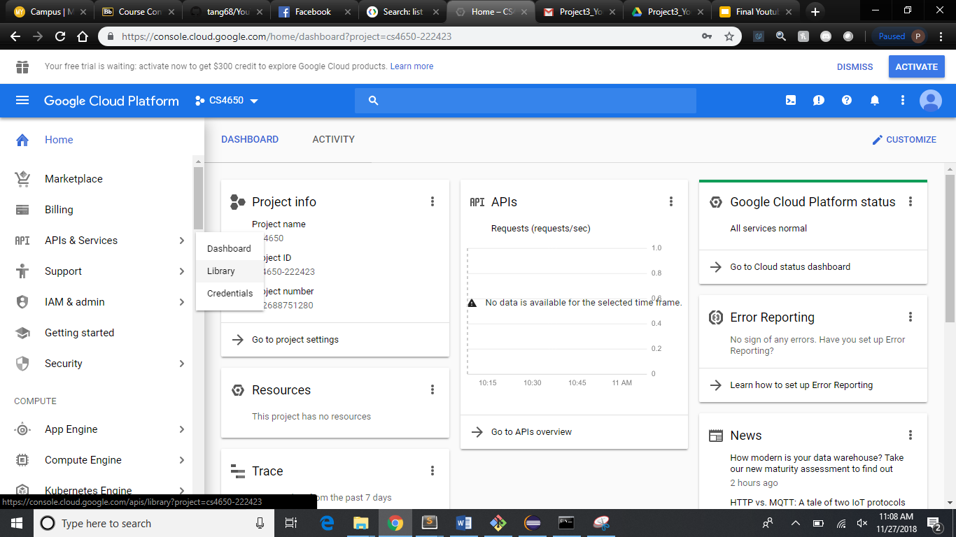
Create a project, go to APIS & Services, library

Slide 5
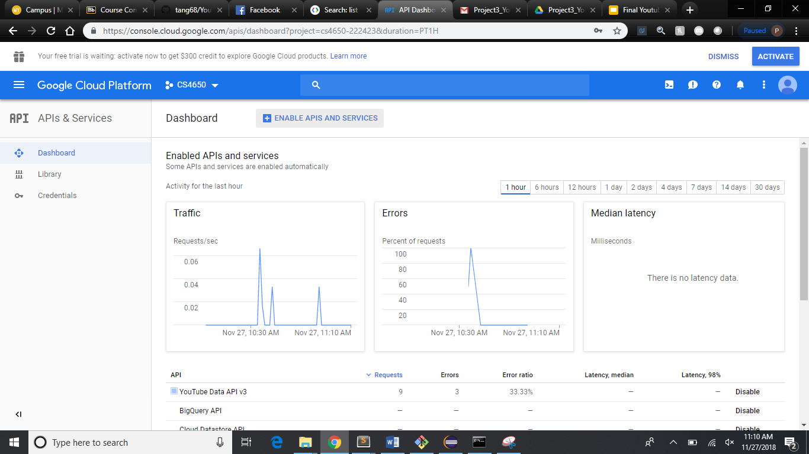
Library allows you to choose and enable API, credential allows you get a file used to access data

Slide 6
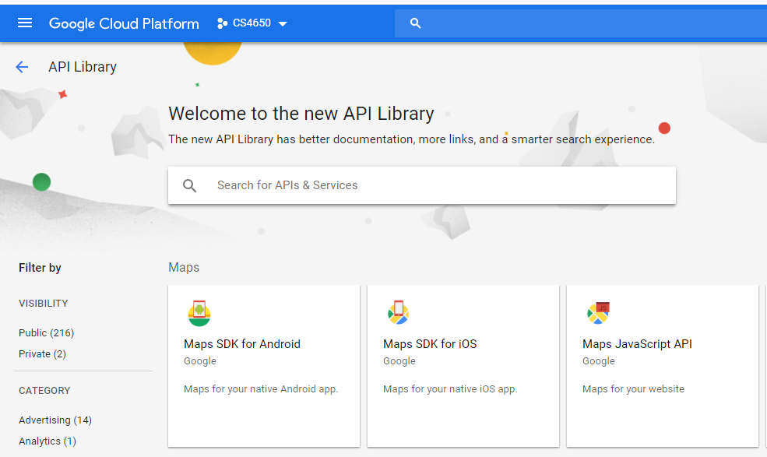
Inside the API Library, you can search for all the available APIs that google provides

Slide 7
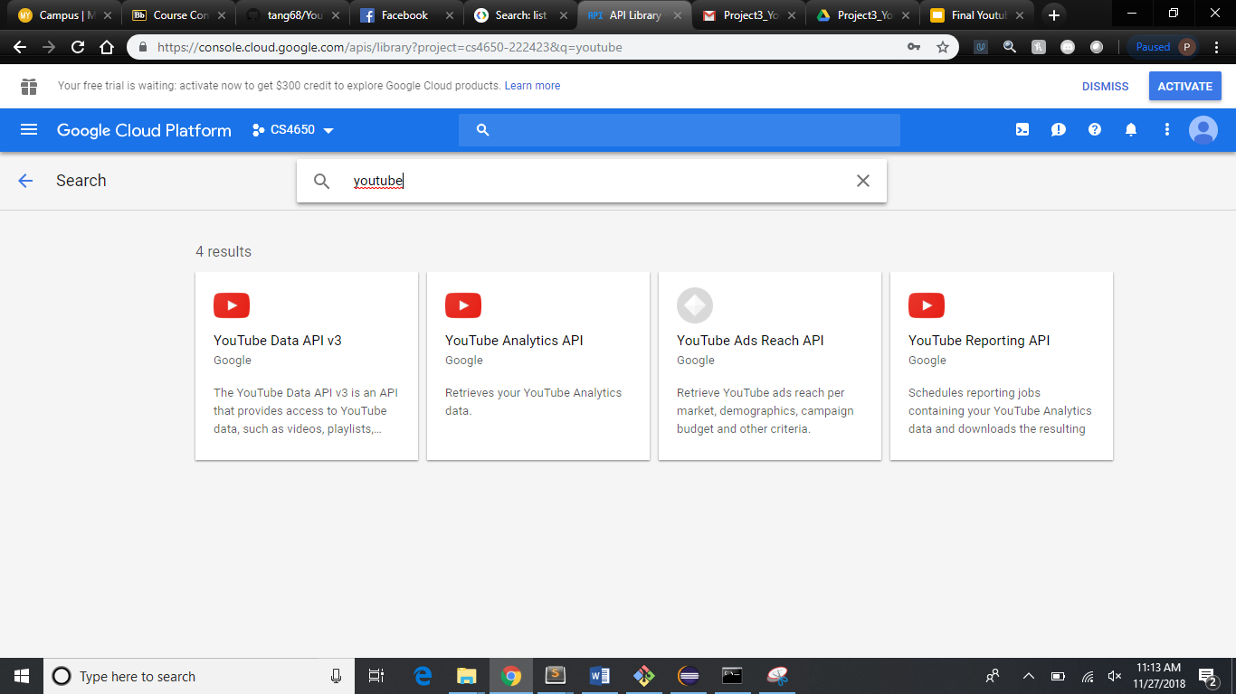
Search for Youtube, and you’ll see the APIs we need, we’ll be using Data API v3 for this demo

Slide 8
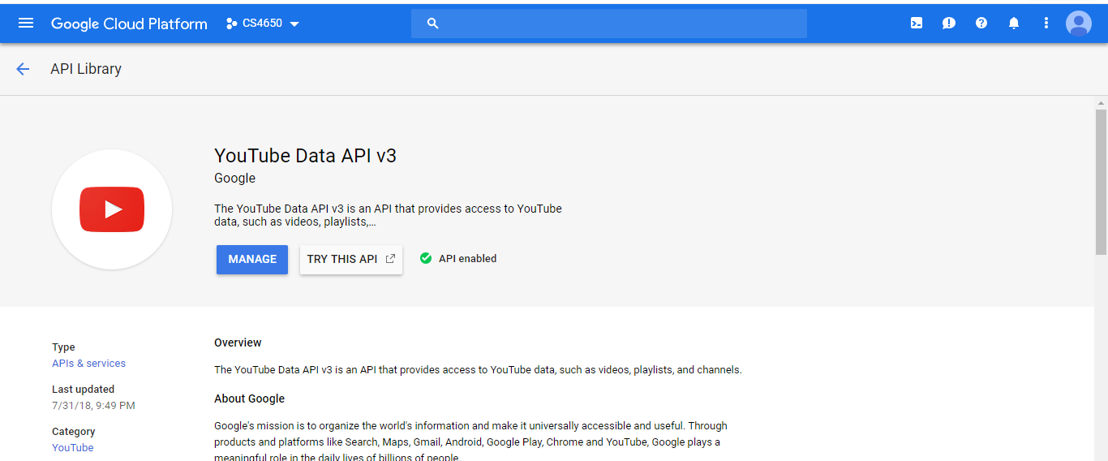
Enable the API

Slide 9
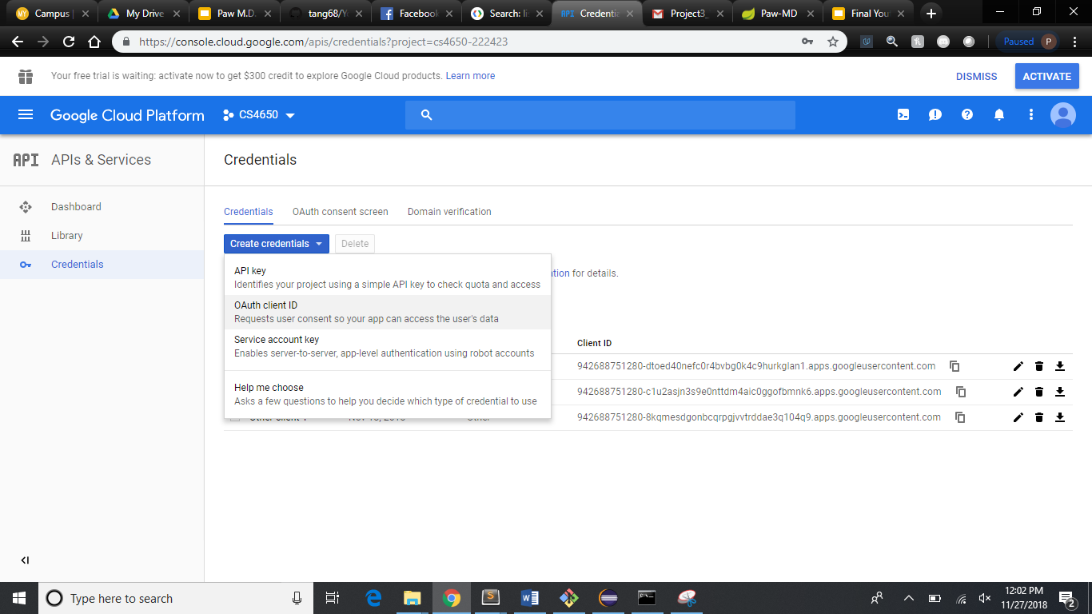
Create and download the credentials file

Slide 10
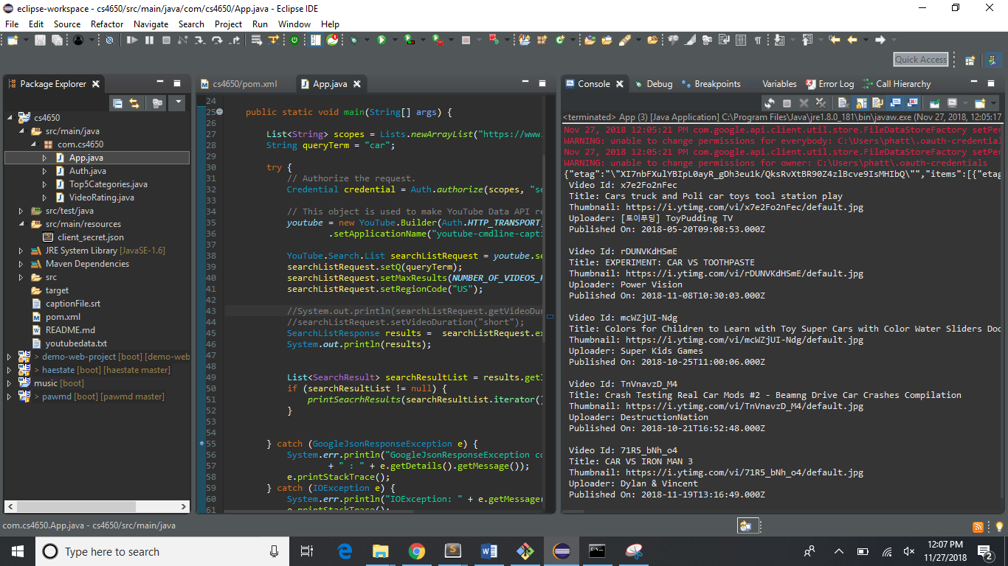

Slide 11
MapReduce

Slide 12
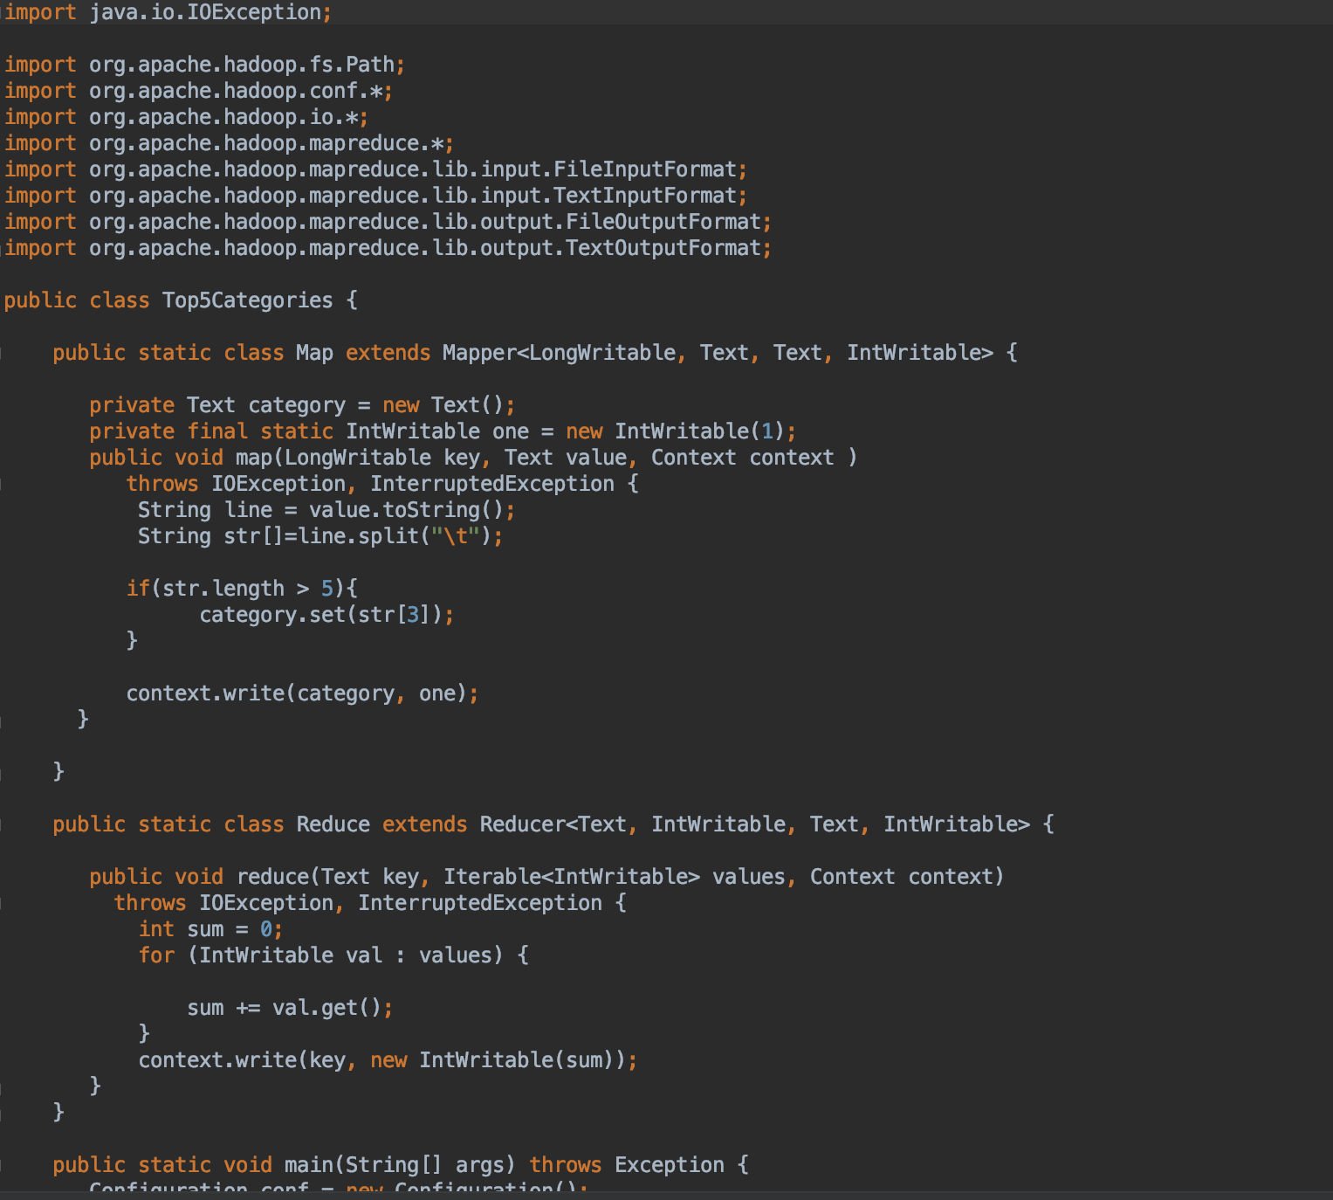
Map Reduce Top5Categories.java

Slide 13
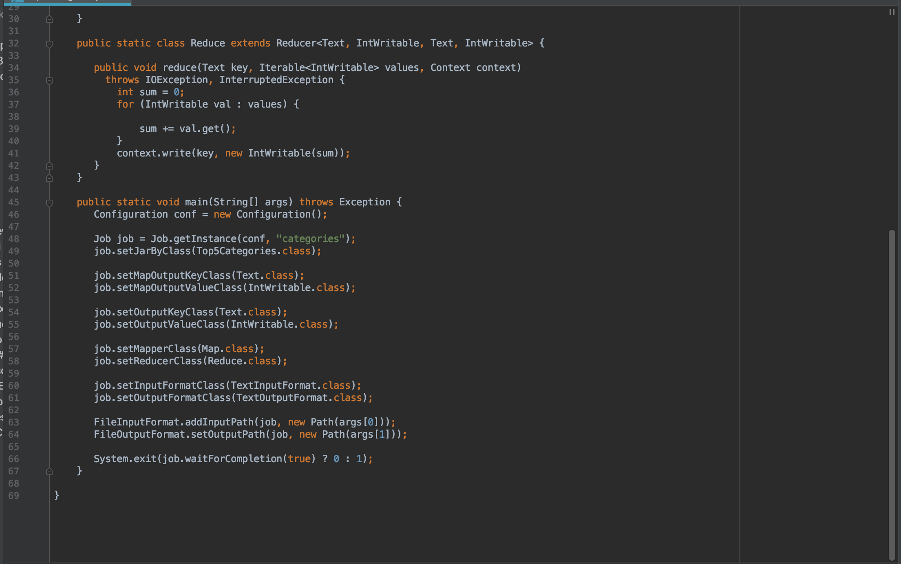

Slide 14
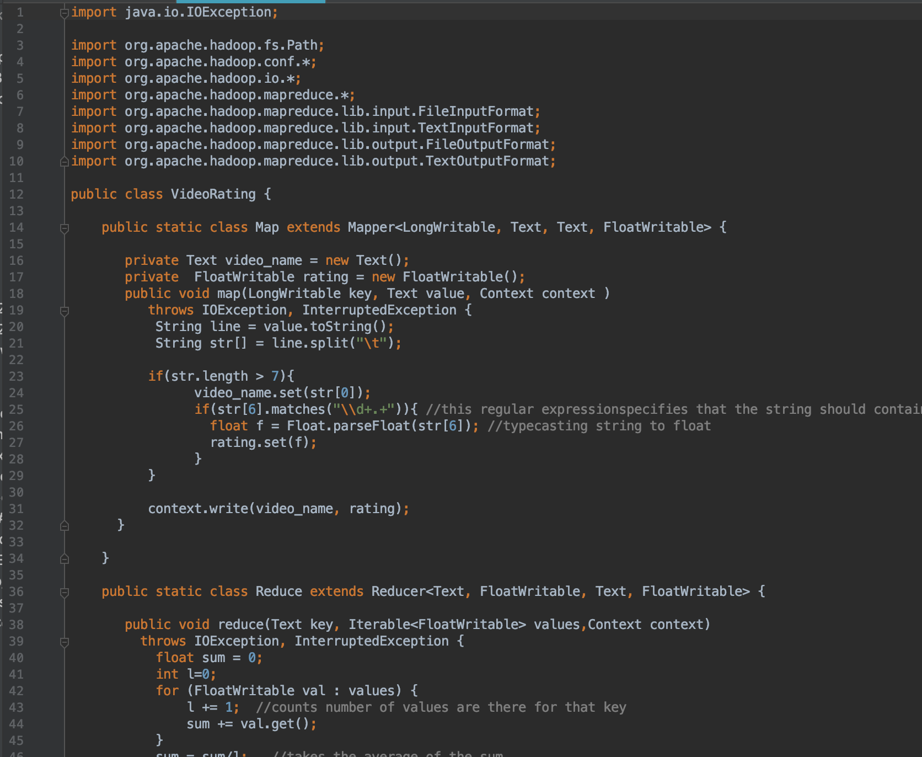
Map Reduce VideoRatings.java

Slide 15
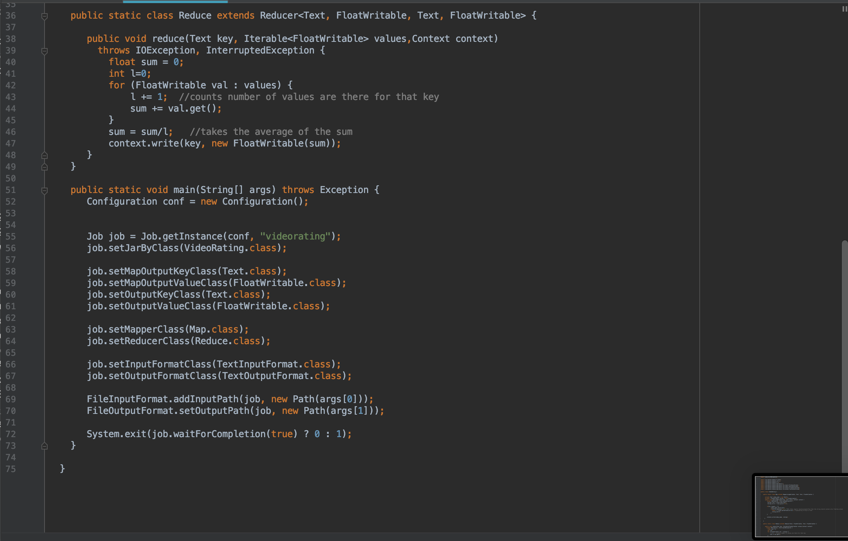

Slide 16
Using Hadoop from Xsede

Slide 17
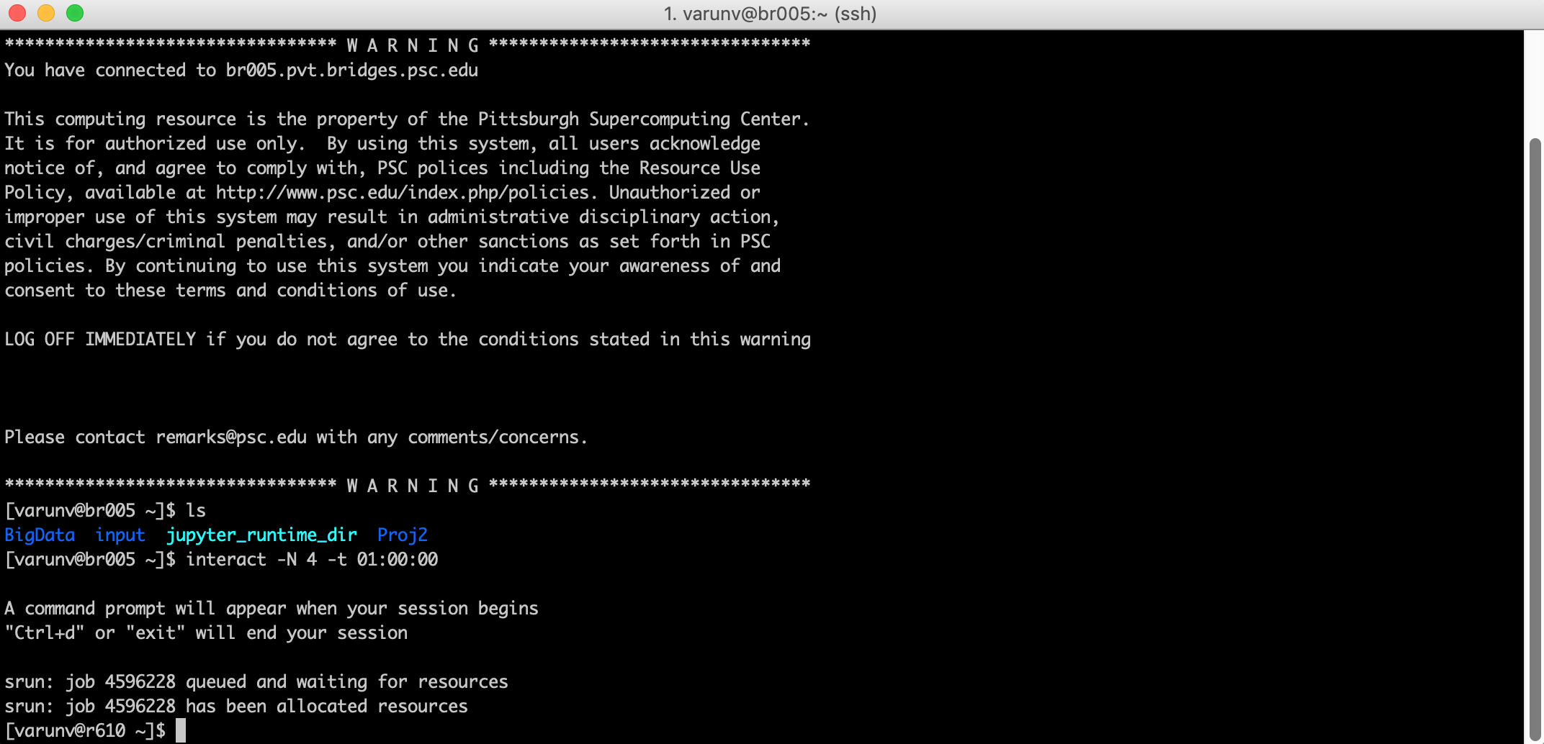
Interact

Slide 18
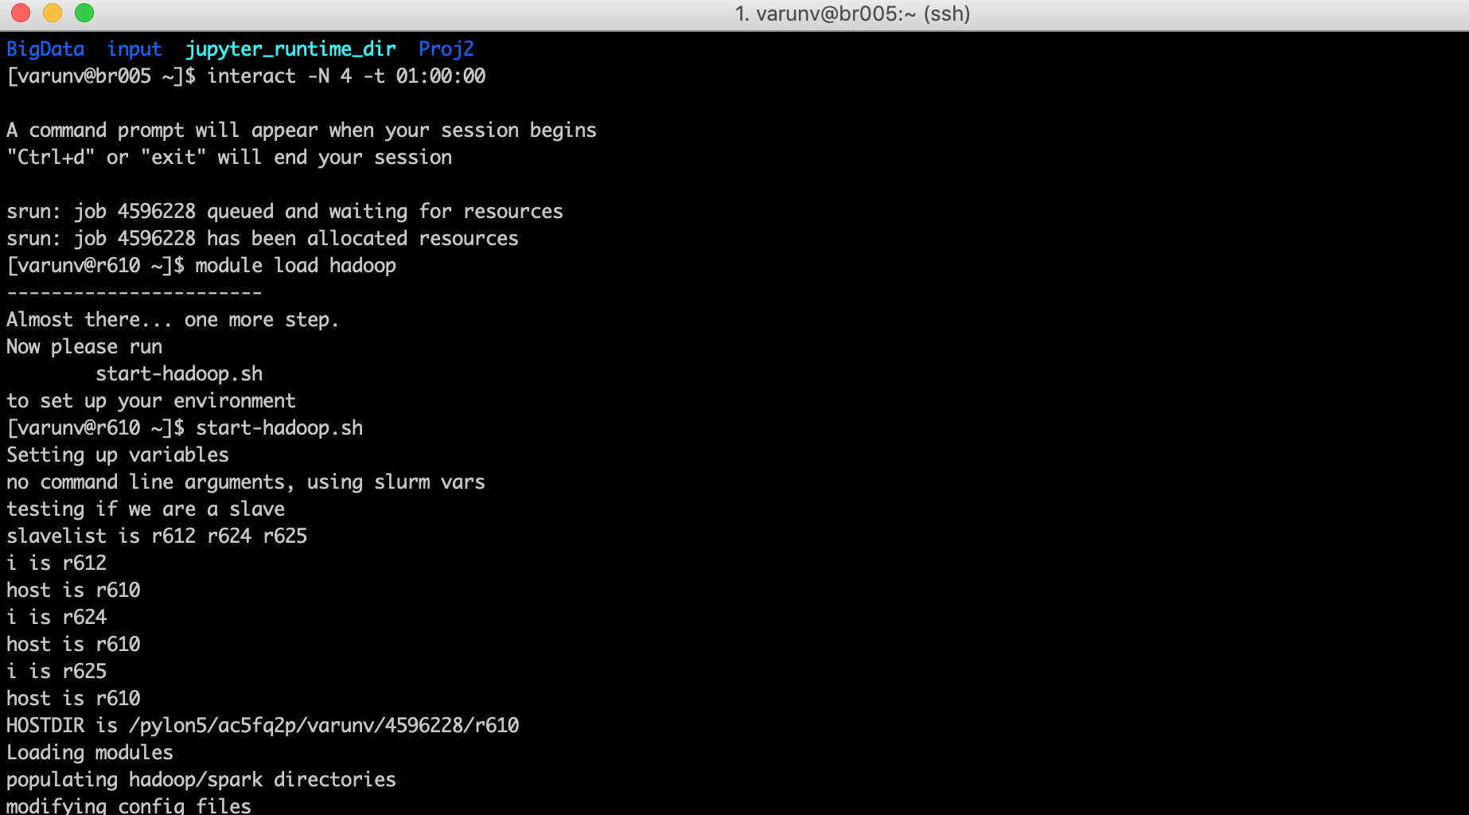
Start-hadoop

Slide 19
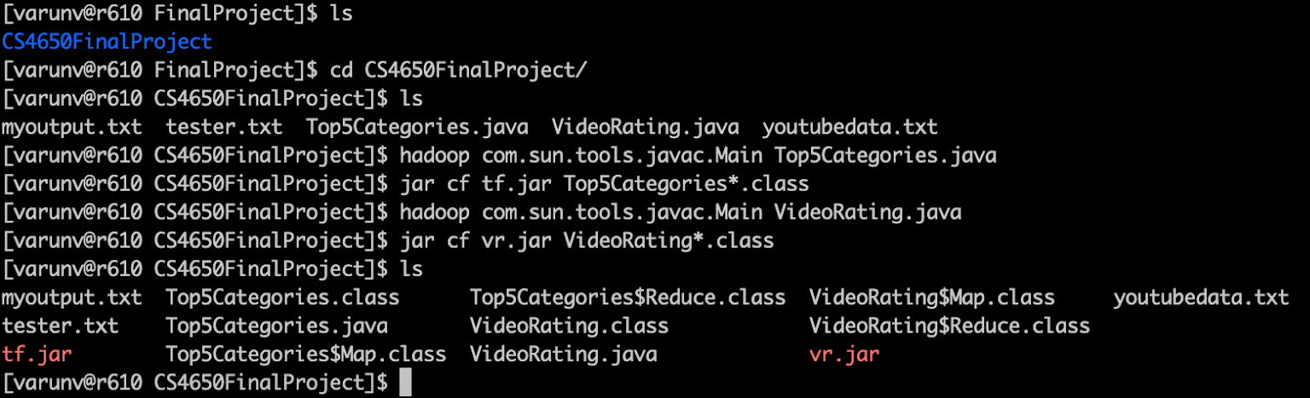
Making jar files for Execution

Slide 20

Put 2GB Youtube Dataset in Hadoop

Slide 21
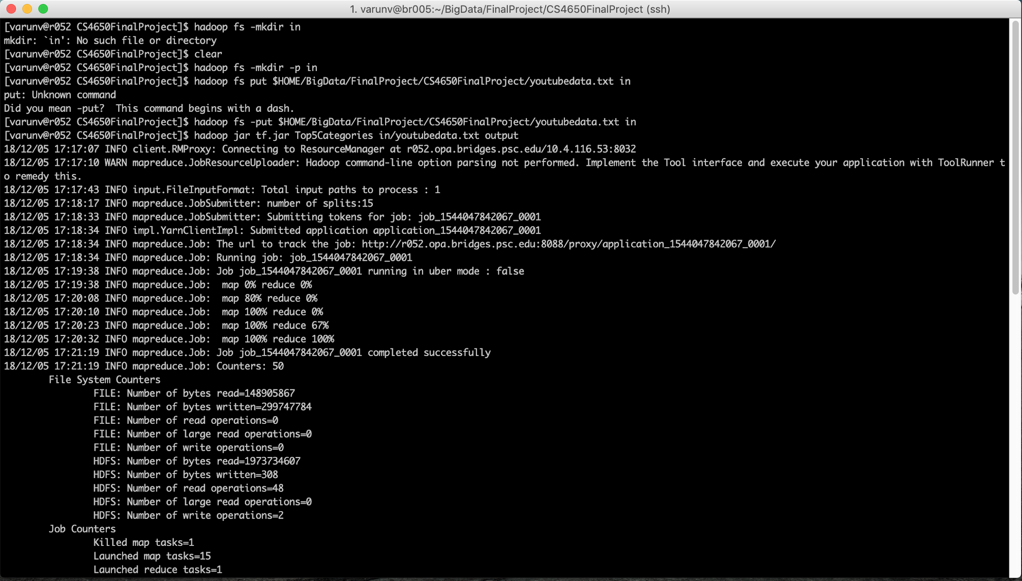
Run Category Breakdown

Slide 22

View Category Results

Slide 23
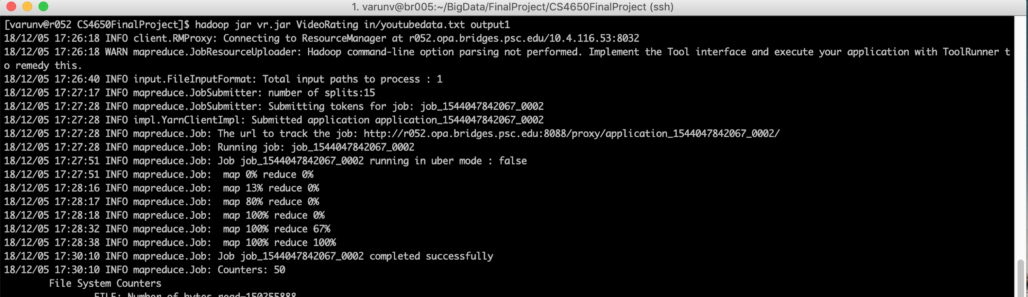
Run Video Rating

Slide 24
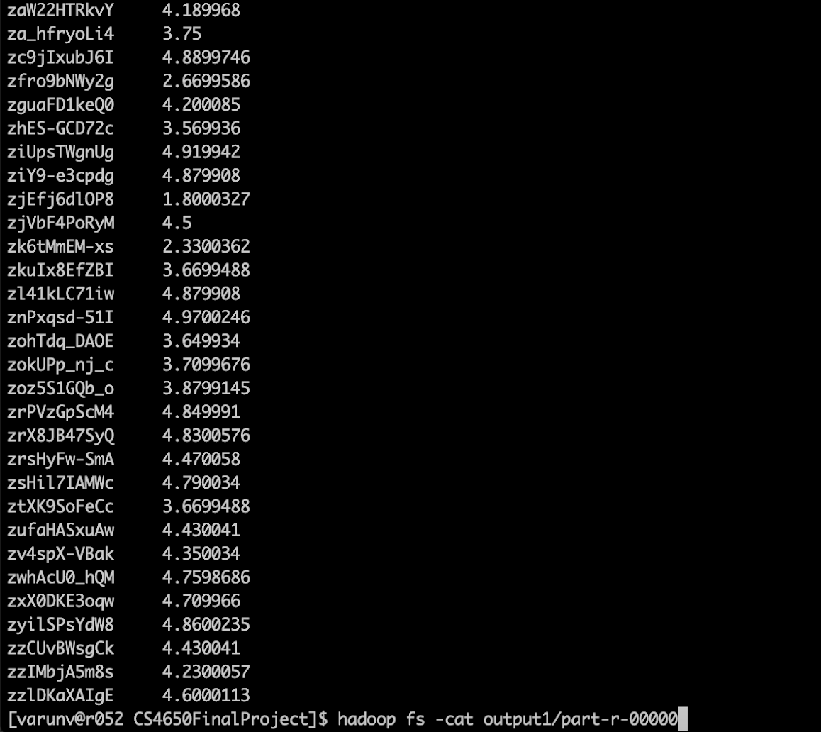
View Video Rating

Slide 25
Analysis:
Using the same 2GB dataset, we achieved 15 splits
Top 5 categories are : Entertainment, Music, Comedy, People/Blogs, and News
Average rating for our video dataset was 3.23

